Slide 1
Neural Network Fundamentals
Lecture 3
Part 1
Generative AI for Computer Vision

Slide 2
Content
Introduction to Neural Network
Application Domains for Neural Network
Single Layer Perceptron (SLP)
SLP: Training Algorithm
SLP: Applications
SLP: Limitations

Slide 3
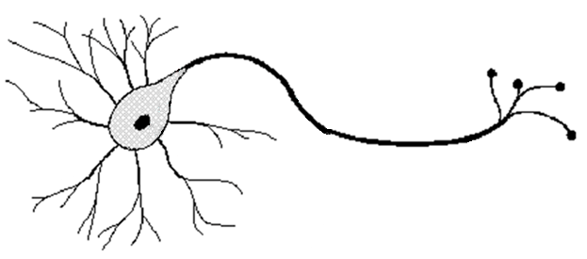
Components of a Biological Neuron
A biological neuron consists of a cell body (soma), dendrites that receive inputs, and an axon that sends outputs.
Neurons communicate through synapses, where the axon of one neuron connects to the dendrite of another neuron.
Electrochemical signals travel from the dendrites through the cell body and along the axon, allowing information to be processed and transmitted throughout the nervous system.
Axon
Soma
Synapse
Dendrite
Biological Neuron
Image Source: Stoianov, Ivilin. (2001). Connectionist lexical processing.

Slide 4










Introduction to Neural Network
Inputs
$x_{0}$=1
Input
Layer
Bias
$$x_{1}$$
$$w_{1}$$
$$w_{0}$$
$$\sum_{i=0}^{n}{w_{i}x_{i}}$$
$$x_{2}$$
$$w_{2}$$
Output
.
..
Activation function
$$w_{n}$$
Hidden
Layer
$$x_{n}$$
Artificial Neuron
Output
Layer
Axon
Soma
Neural Network
Synapse
Dendrite
Biological Neuron

Slide 5









Introduction to Neural Network
Axon
An Artificial Neural Network (ANN) is a computational model inspired by biological neural networks. Its basic processing unit is the artificial neuron, which forms the foundation of the network.
The basic unit of an ANN is an artificial neuron, which processes information through three operations: multiplication, summation, and activation.
Soma
Synapse
Dendrite
Biological Neuron
Inputs
$x_{0}$=1
Bias
$$x_{1}$$
$$w_{1}$$
$$w_{0}$$
$$\sum_{i=0}^{n}{w_{i}x_{i}}$$
$$x_{2}$$
$$w_{2}$$
Output
.
..
Activation function
$$w_{n}$$
$$x_{n}$$
Artificial Neuron

Slide 6









Introduction to Neural Network
Input Level: Input values from the data are multiplied by their corresponding weights, which determine the importance of each input.
Body Level: All weighted inputs are added together along with a bias value to produce a weighted sum.
Output Level: The weighted sum is passed through an activation function to generate the final output of the neuron.
Inputs
$x_{0}$=1
Bias
$$x_{1}$$
$$w_{1}$$
$$w_{0}$$
$$\sum_{i=0}^{n}{w_{i}x_{i}}$$
$$x_{2}$$
$$w_{2}$$
Output
.
..
Activation function
$$w_{n}$$
$$x_{n}$$
Artificial Neuron

Slide 7
Applications of Neural Network
Applications of Neural Network
Non-Linear and Complex Problems
Neural networks can effectively handle problems where the relationship between inputs and outputs is highly non-linear or mathematically ill-defined. Examples: Image classification, speech recognition, and other pattern recognition tasks.
Data-Rich Problems
Neural networks perform well in domains where large amounts of labeled or unlabeled data are available for training.
Examples: Recommendation systems, sentiment analysis, and customer behavior prediction.
Pattern Recognition Tasks
Neural networks are effective at identifying patterns, features, and regularities within large and complex datasets.
Examples: Face recognition, handwritten digit recognition, and object detection.
Noisy or Uncertain Data Environments
Neural networks can handle incomplete, noisy, or inconsistent data while still making reliable predictions.
Examples: Sensor data analysis, medical diagnosis, and fault detection systems.
Problems with No Explicit Algorithm
Neural networks can learn solutions for tasks where no clear set of rules exists.
Examples: Machine translation, emotion detection, and speech understanding.

Slide 8










Single Layer Perceptron (SLP)
Components of a SLP:
Inputs: The SLP takes multiple inputs (x₁,x₂,…,x_{n})
Weights: Each input is associated with a weight (w₁,w₂,…,w_{n}).
Bias: A bias term (b) is added to shift the decision boundary.
Activation Function: A step function (a simple thresholding function) is generally used as activation function.
The step function is defined as:
Binary Output: The output of a perceptron is binary (1 or 0), making it suitable for linearly separable classification problems.
Inputs
$x_{0}$=1
Bias
$$x_{1}$$
$$w_{1}$$
$$w_{0}$$
$$\sum_{i=0}^{n}{w_{i}x_{i}}$$
$$x_{2}$$
$$w_{2}$$
Output
.
..
Activation function
$$w_{n}$$
$$x_{n}$$
Single Layer Perceptron
(with single output)

Slide 9
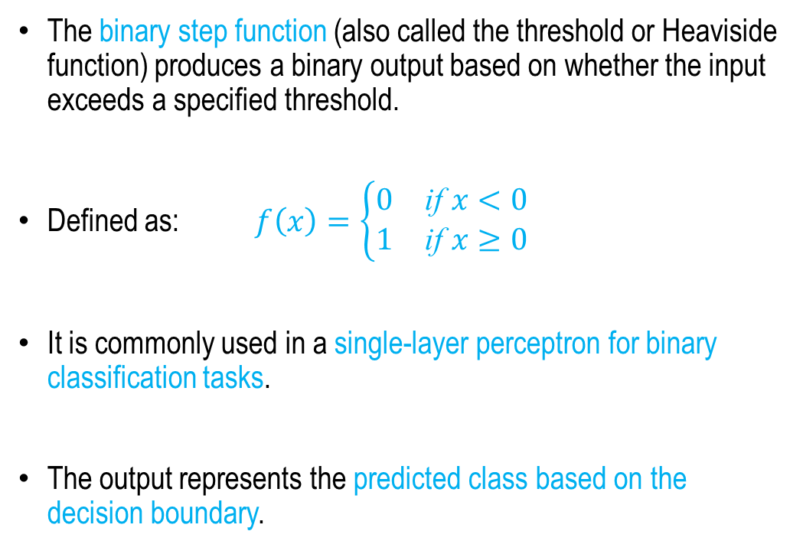
Binary Step Function
The binary step function (also called the threshold or Heaviside function) produces a binary output based on whether the input exceeds a specified threshold.
Defined as: $f\left(x\right)=\left\{\begin{matrix}0 & \text{if} x<0 \\ 1 & \text{if} x≥0\end{matrix}\right.$
​It is commonly used in a single-layer perceptron for binary classification tasks.
The output represents the predicted class based on the decision boundary.
1.0
0.6
0.2
-0.2
-2 0 2

Slide 10


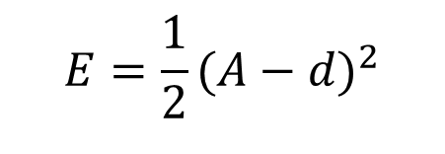
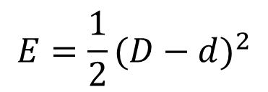
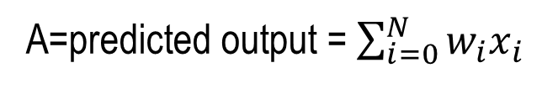
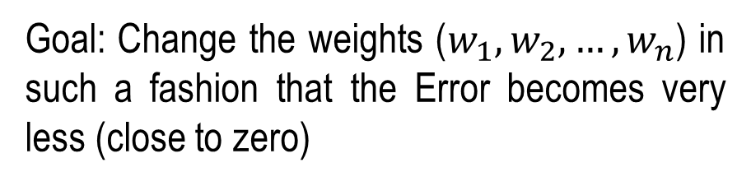
Single Layer Perceptron (SLP)
A=predicted output = $\sum_{i=0}^{N}{w_{i}x_{i}}$
Inputs
$x_{0}$=1
Bias
d = actual (target) output
$$x_{1}$$
$$w_{0}$$
$$w_{1}$$
$$\sum_{i=0}^{n}{w_{i}x_{i}}$$
$$E=\frac{1}{2}{(A−d)}^{2}$$
$$x_{2}$$
$$w_{2}$$
Output
.
..
Activation function
$$w_{n}$$
$$x_{n}$$
Goal: Change the weights ($w_{1},w_{2},…,w_{n}$) in such a fashion that the Error becomes very less (close to zero)
Single Layer Perceptron
(with single output)

Slide 11






Single Layer Perceptron (SLP)
Linear Separability: A perceptron can classify data only if the classes are separated by a straight line or hyperplane.
Works for linearly separable problems.
Cannot solve non-linearly separable problems such as XOR.
Single-Layer Model: The perceptron has only one layer and no hidden layers.
Simple and easy to implement.
Limited in learning complex patterns and relationships.
$$X_{2}$$
$$X_{1}$$
Linearly Separable
$$X_{2}$$
X | Y | O/P
0 | 0 | 0
0 | 1 | 1
1 | 0 | 1
1 | 1 | 0
$$X_{2}$$
$$X_{1}$$
XOR representation
(Linear non-separable task)
$$X_{1}$$
XOR Logic
Not Linearly Separable

Slide 12
Summary
Introduction to Neural Network
Application Domains for Neural Network
Single Layer Perceptron (SLP)
SLP: Training Algorithm
SLP: Applications
SLP: Limitations

Slide 13
Neural Network Fundamentals
Next
Lecture 3: Part II
Generative AI for Computer Vision

